Slide 1


Slide 2
JOINS
JOINS are used to retrieve data from multiple tables. It is performed whenever two or more tables are joined in a SQL statement.
INNER JOIN (or sometimes called simple join)
LEFT OUTER JOIN (or sometimes called LEFT JOIN)
RIGHT OUTER JOIN (or sometimes called RIGHT JOIN)
FULL OUTER JOIN (or sometimes called FULL JOIN)
CROSS JOIN (or sometimes called CARTESIAN JOIN)
TYPES

Slide 3
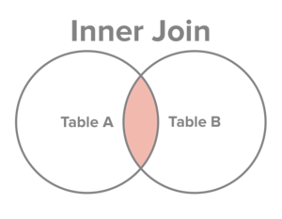
INNER JOIN
INNER JOIN compares each row of table1 with each row of table2 to find all pairs of rows which satisfy the join-predicate. When satisfied, column values for each matched pair of rows of A and B are combined into a result row.
SELECT columns
FROM table1
INNER JOIN table2
ON table1.column = table2.column;
Syntax

Slide 4
INNER JOIN
INNER JOIN compares each row of table1 with each row of table2 to find all pairs of rows which satisfy the join-predicate. When satisfied, column values for each matched pair of rows of A and B are combined into a result row.
SELECT
a.order_line ,
a.product_id,
a.customer_id,
a.sales,
b.customer_name,
b.age
FROM sales_2015 AS a
INNER JOIN customer_20_60 AS b
ON a.customer_id = b.customer_id
ORDER BY customer_id;
Example

